Slide 1
CS 2200
LAB 11

Slide 2
Brief Overview:
Parallelism, Process Synchronization, Thought Experiments, Data Races, Locks

Slide 3
Announcements
Exam 3 was today
Project 4 is due April 8th @ 11:59PM
Homework 8 releases tonight and is due next Wednesday!
NOTE: Makeup demos happening after lab today!

Slide 4
Process Synchronization

Slide 5
Terminology
Thread: A single path of control
There can be more than one thread for a single process
The “state” of a multithreaded process is the state of all of its threads
Synchronization: synchronized execution across multiple threads.
Race condition: Multiple concurrent threads operating on the same piece of shared data.
Causes unpredictable behavior
Communication: Inter-thread sharing of data (IPC)

Slide 6
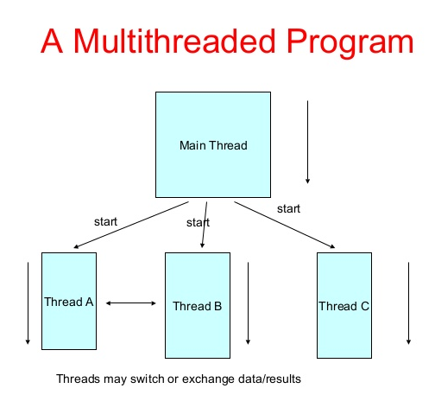
Why do we need parallel computation?
Single-threaded CPU performance is starting to taper off, performance is limited by using a single processor.
Solve problems that are too large to fit on a single CPU.
Solve problems that can’t be solved in a reasonable time.
Run multiple things all simultaneously on the processor without waiting.

Slide 7
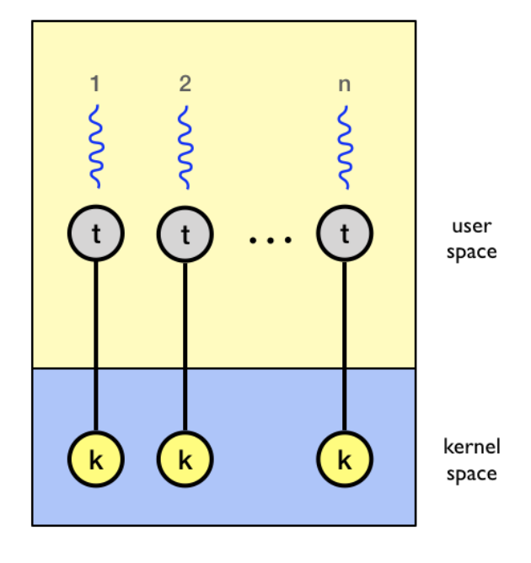
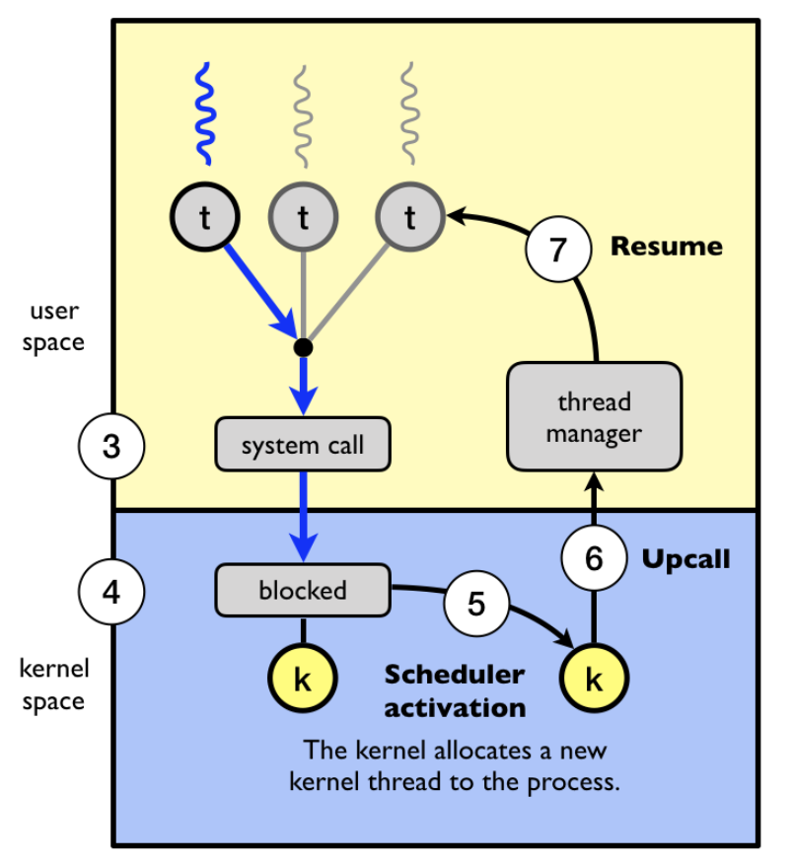
Implementing Threads
There are two flavours of threading, user and kernel level threading.
It simply refers to who has the burden of managing and supporting the threads, whether it is the user process or the operating system itself.
Kernel-level threads - all code and data structures for the library exists within the kernel space. Invoking a function in the library will normally trigger a syscall.
User-level threads - all code and data structures for the library exists within the user space. Invoking a function in the library will run a local command, not a syscall.
Notes:
hw that was alr due

Slide 8
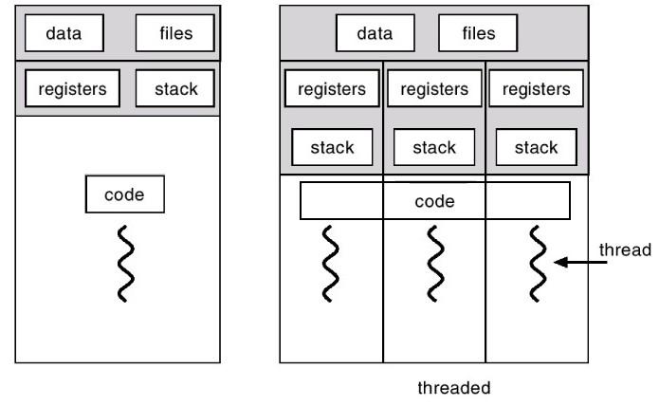
Threads in the OS
A thread shares with its peer threads its:
Code segment
Data segment
Operating-system resources, e.g., when one thread alters a code segment memory item, all other threads see that, and a file open with one thread is available to others.
But threads will have their own personal stack
Called cactus stack

Slide 9
Exercise
What is the value of A after both threads are run?
A = 0; //shared resource
Thread 1
{
x = A;
x += 1;
A = x;
}
Thread 2
{
y = A;
y += 1;
A = y;
}
Notes:
data race

Slide 10
Exercise
What is the value of A after both threads are run?
Either of the following: 1, 2
A = 0; //shared resource
Thread 1
{
x = A;
x += 1;
A = x;
}
Thread 2
{
y = A;
y += 1;
A = y;
}
Notes:
data race

Slide 11
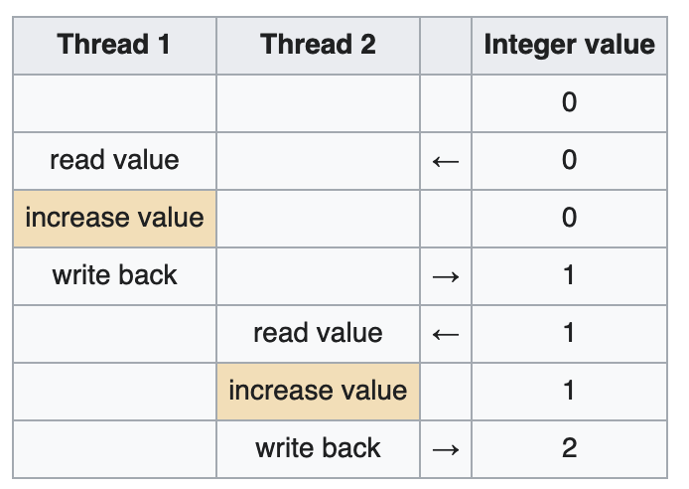
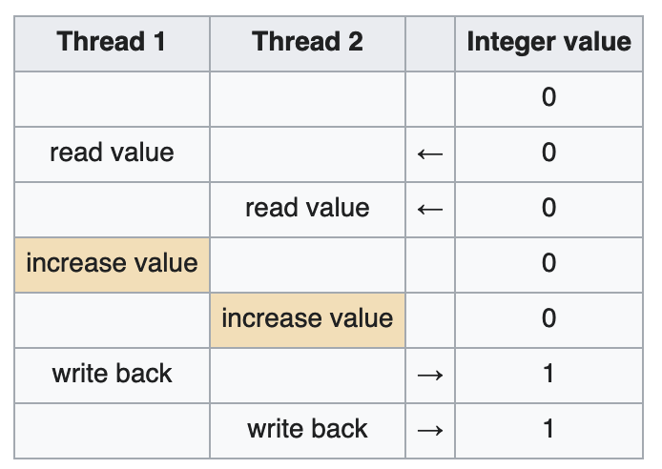

Slide 12
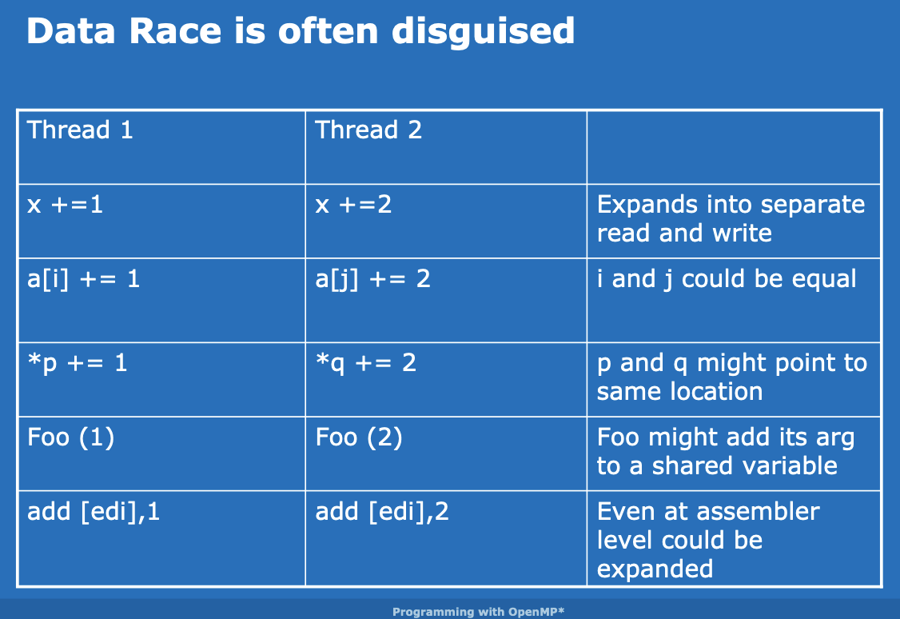
Dangers of a Data Race, Its bad!

Slide 13
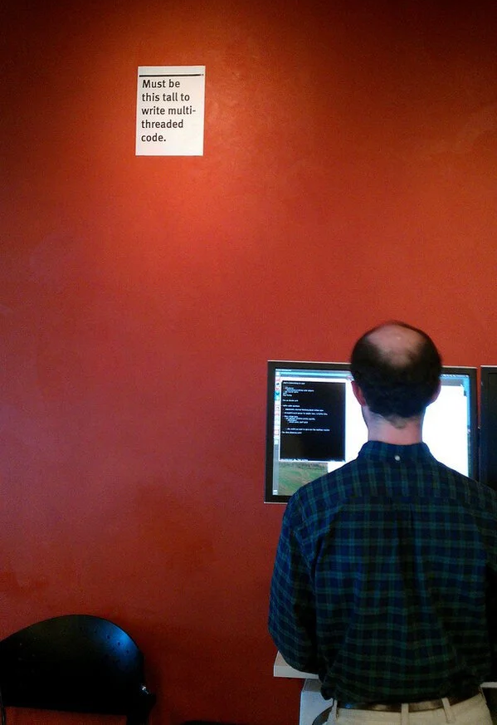
Issues
Data Races
Synchronization
Deadlocks
Livelocks
Priority Inversion
Load Balancing Problem
Memory Contention & Bandwidth
Large Communication Overhead
Non-Determinacy
Starvation
Cache Coherency Problems
And many more ...

Slide 14

How do we prevent data races?
Control memory accesses to a shared resource
Example: use atomic instructions, prevent multiple threads from accessing a resource at the same time with locks.
Thread 1
{
lock(&lk);
x = A;
x += 1;
A = x;
unlock(&lk);
}
Thread 2
{
lock(&lk);
y = A;
y += 1;
A = y;
unlock(&lk);
}

Slide 15
Lock Implementations
int lock = 0; // shared var
void acquire(int *lock) {
while (*lock) /* wait */ ;
*lock = true;
}
void release(int *lock) {
*lock = false;
}
Is this code correct?

Slide 16
No!
int lock = 0; // shared var
void acquire(int *lock) {
while (*lock) /* wait */ ;
*lock = true;
}
void release(int *lock) {
*lock = false;
}
The lock could be acquired by another thread between checking the lock and acquiring the lock, since these operations aren’t atomic.

Slide 17
Lock Implementations
Does this work?
void spin_lock(struct spinlock *lock) {
while (test_and_set(&lock->locked));
}

Slide 18
Is this code correct?
A = 0; //shared resource
Thread 1
{
lock(&lk);
if (A > 10)
return -1;
A += 1;
unlock(&lk);
}
Thread 2
{
lock(&lk);
A += 1;
unlock(&lk);
}
Notes:
yes - is protected

Slide 19
Mutex
Mutual exclusion locks “locks” shared pieces of data to ensure that only one thread is operating on it at a time.
Ensures atomicity of critical sections of code.
Critical section: part of the code operated on in a mutually exclusive manner.
Need to be careful — wrapping large amounts of code in locks increases the runtime of a multithreaded process.
In C:
pthread_mutex_trylock(lock) non-blocking
pthread_mutex_lock(lock) blocking
pthread_mutex_unlock(lock)
Problem: What happens if a thread becomes unable to release a lock?

Slide 20
How do I fix a deadlock in this code?
A = 0; //shared resource
Thread 1
{
lock(&lk);
if (A > 10)
return -1;
A += 1;
unlock(&lk);
}
Thread 2
{
lock(&lk);
A += 1;
unlock(&lk);
}

Slide 21
How do I fix a deadlock in this code?
A = 0; //shared resource
Thread 1
{
lock(&lk);
if (A > 10){
unlock(&lk);
return -1;
}
A += 1;
unlock(&lk);
}
Thread 2
{
lock(&lk);
A += 1;
unlock(&lk);
}

Slide 22
Exercise
What could be the outcome of running this code?
// Thread 1
lock(mutexA);
doCalculations(aVar);
lock(mutexB);
printf(“AB is %d%d”, aVar, bVar);
unlock(mutexB);
unlock(mutexA);
// Thread 2
lock(mutexB);
doCalculation(bVar);
lock(mutexA);
printf(“AB is %d%d”, aVar, bVar);
unlock(mutexA);
unlock(mutexB);

Slide 23
Exercise
What could be the outcome of running this code?
// Thread 1
lock(mutexA);
doCalculations(aVar);
lock(mutexB);
printf(“AB is %d%d”, aVar, bVar);
unlock(mutexB);
unlock(mutexA);
// Thread 2
lock(mutexB);
doCalculation(bVar);
lock(mutexA);
printf(“AB is %d%d”, aVar, bVar);
unlock(mutexA);
unlock(mutexB);
A deadlock can occur because each thread is waiting indefinitely for the mutex held by the other thread, causing the program to hang.

Slide 24
Deadlocking
When one or more thread is waiting for an event that will never happen.
Example: I’m waiting for Bill Gates to give me a million dollars.
Livelocking: special case of deadlocking, when a thread is actively checking for an event that will never happen.
Example: I keep calling Bill Gates asking if he is going to give me a million dollars.

Slide 25
Producer Consumer Examples
Simplified example, where producer is much slower than the consumer, so it will never overfill the queue.
void producer(int v)
{
lock(lk);
q.push();
cond.signal();
unlock(lk);
}
void consumer(int v)
{
lock(lk);
if (q.empty())
cond.wait();
q.pop();
unlock(lk);
}

Slide 26
Example with Multiple Consumers
void producer(int v)
{
lock(lk);
q.push();
cond.signal();
unlock(lk);
}
// producer will output cond signal
What could go wrong here?
void consumer(int v)
{
lock(lk);
if (q.empty())
cond.wait();
q.pop();
unlock(lk);
}
// consumer 1 will start running but be switched out
void consumer(int v)
{
lock(lk);
if (q.empty())
cond.wait();
q.pop();
unlock(lk);
}
// consumer 2 will check that its not empty and pop

Slide 27
queue size
0
0
1
0
????????
producer
lock(lk);
q.push();
cond.signal();
unlock(lk);
consumer 1
lock(lk);
if (q.empty())
cond.wait();
q.pop();
unlock(lk);
consumer 2
lock(lk);
if (q.empty())
cond.wait();
q.pop();
unlock(lk);

Slide 28
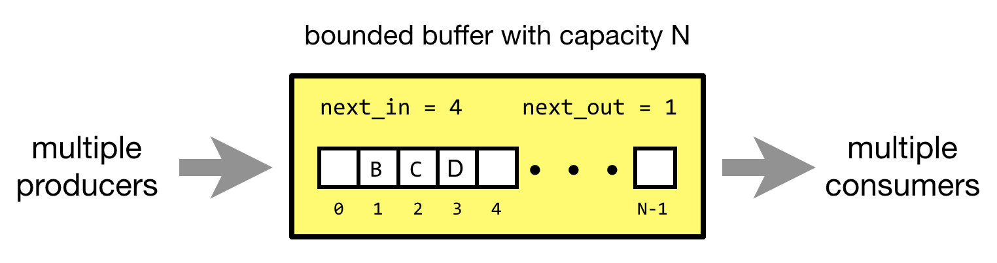
Bounded Buffer Problem
We have multiple threads that act as either producers or consumers. Producers will add their data to a buffer of a fixed size and consumers will remove elements from the array.

Slide 29
Solution
void producer(int v)
{
lock(lk);
q.push();
cond.signal();
unlock(lk);
}
Condition now gets checked after getting the lock from cond.wait() and if condition is no longer true the thread waits again.
void consumer(int v)
{
lock(lk);
while (q.empty())
cond.wait();
q.pop();
unlock(lk);
}
void consumer(int v)
{
lock(lk);
while (q.empty())
cond.wait();
q.pop();
unlock(lk);
}
Put the cond.wait() in a while loop.

Slide 30
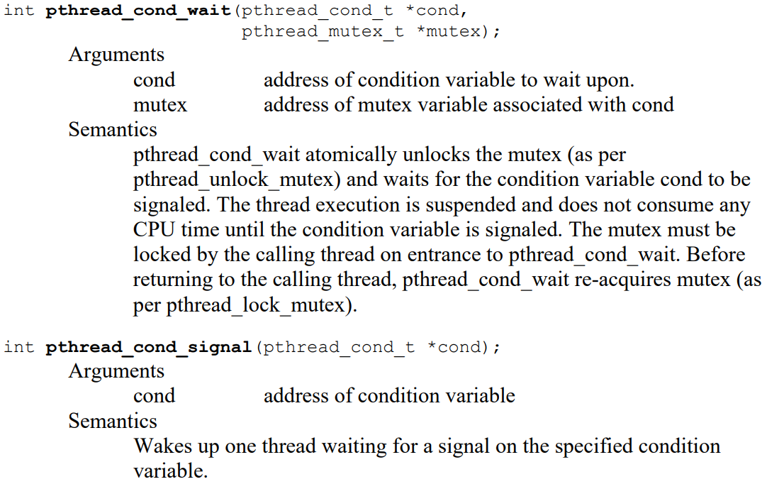
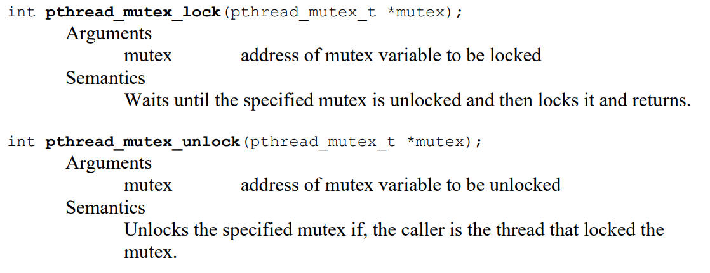
pthread Library

Slide 31
Thanks for Attending :)

